Slide 1





Group 3
PROJECT 4
AMADOU DIALLO
KARLEE CROSE
SHANICE CUMMINGS
ZACH HORN

Slide 2


Introduction
WHAT CONTRIBUTES TO DEPRESSION?
Depression is a growing public health concern, affecting millions of people worldwide.
In this project, we leverage machine learning to analyze a dataset of potential risk factors—ranging from demographics and lifestyle habits to medical history. By identifying patterns within the data, our goal is to gain deeper insights into what influences depression and how predictive models can aid in early detection and intervention.

Slide 3
DATA SOURCE
Data was sourced from kaggle.
Sex
Age
Height
Weight
BMI
Smoking History
Alcohol Consumption
Fruit Consumption
Green Vegetable Consumption
Fried Potato Consumption
Key Variables:

Slide 4
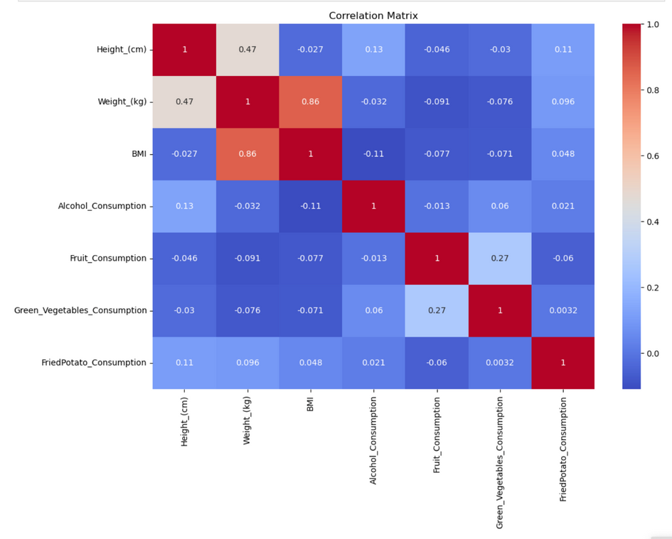
Correlation
Matrix
Height and Weight - 0.47 correlation
Weight and BMI - 0.86 correlation
Height and BMI - -0.027 correlation
Fruit and Green Vegetable Consumption - 0.27 correlation

Slide 5



Correlation Matrix
KEY POINTS
Height & Weight
Weight and BMI are highly correlated, meaning weight plays a critical role in BMI determination.
Height has little effect on BMI, as expected.
Dietary Factors
Healthy eating habits (fruit and vegetable consumption) are positively correlated, which is a good indicator of consistent dietary patterns.
Fried potato consumption does not strongly correlate with other health factors, meaning it might be consumed independently of overall dietary habits.

Slide 6
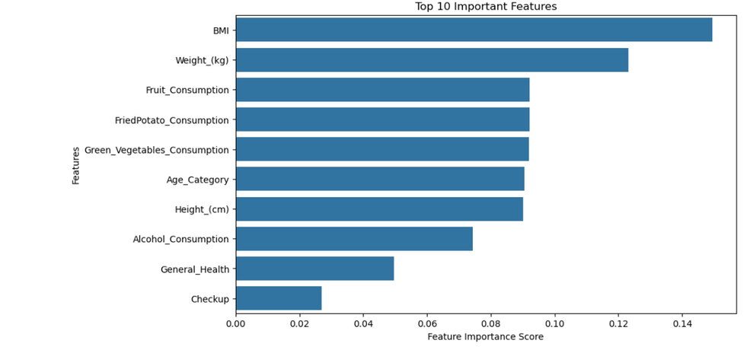
TOP 10 FEATURES
SelectKBest function was used to determine the best features
“Depression” was target column.
Used Random Forest model to rank the features based on importance.
Surprising Find
Fruit consumption was a more important feature than alcohol consumption when it relates to depression.

Slide 7
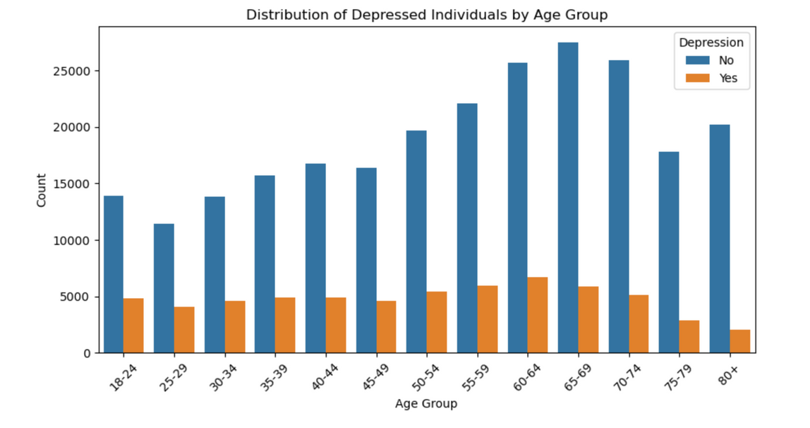
Depression by
AGE GROUP
No significant changes amongst most of the age groups. Although, cases seemed to decrease after the age of 75.

Slide 8
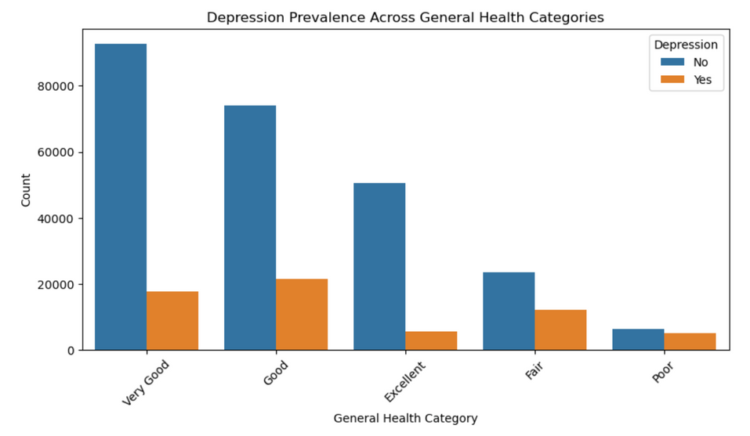
Depression by
GENERAL HEALTH
The gap between those with and without depression decreased as general health decreased. Those with very good health were least likely to have depression.

Slide 9
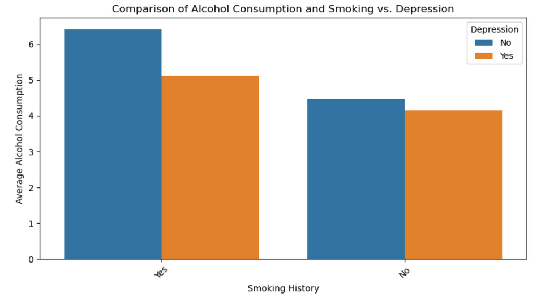
ALCOHOL VS SMOKING
As a whole, individuals who both smoked and consumed alcohol were more likely to have depression than those who only smoked.
However, having both habits did not guarantee a depression diagnose. A larger number of this group did not have depression.

Slide 10
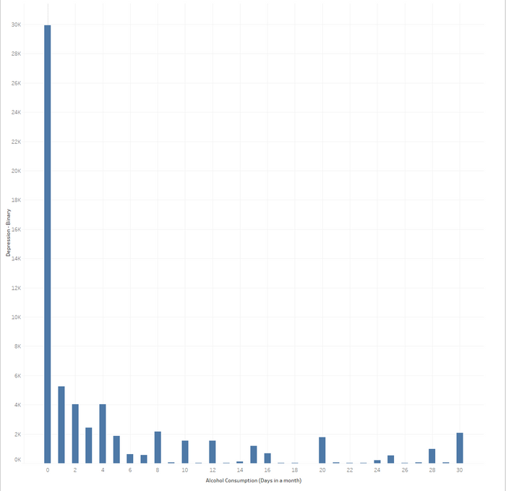
Increasing
ALCOHOL INTAKE
People with depression might abstain from alcohol to avoid worsening their symptoms, leading to higher depression counts among non-drinkers. Conversely, some individuals might use alcohol as a form of self-medication, which can initially reduce symptoms but eventually lead to increased depression.
Some studies indicate that moderate alcohol consumption may have a protective effect against depression, while excessive consumption is linked to higher depression rates. This could explain why the graph shows lower depression levels with moderate alcohol consumption.

Slide 11
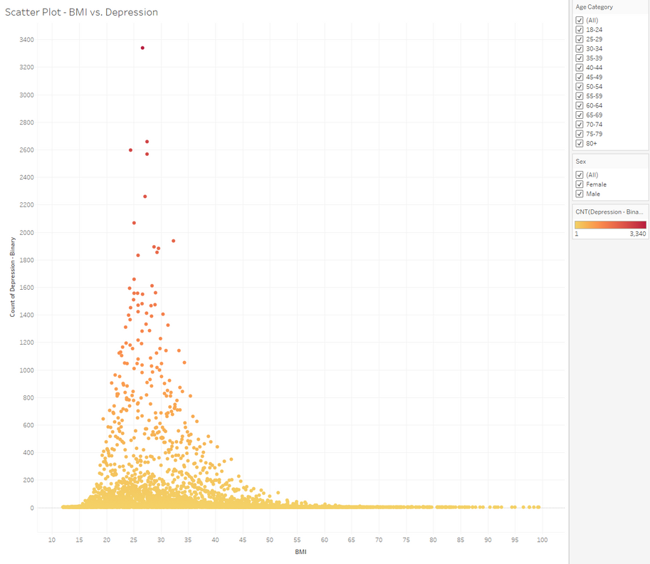
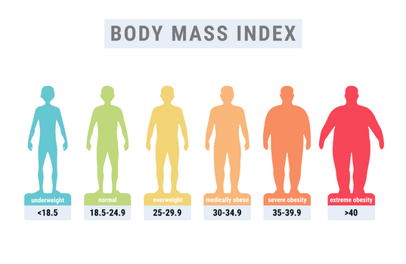
How BMI Correlates into Depression
This range tends to cluster between the 20-45 BMI, which is considered suggesting that individuals in these ranges might have a higher likelihood of depression.The highest counts of depression we see are those over 25, however.

Slide 12
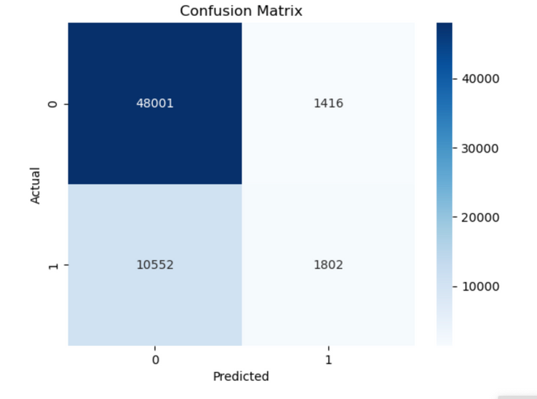
Model 1
RANDOM FOREST MODEL
Accuracy: 80.6%
While the accuracy appears decent, it can be misleading if the classes are imbalanced.
Precision: 56.0%
A relatively low precision indicates a high false positive rate.
Potential Adjustments:
Adjust classification threshold
Rebalance the dataset
Use a different metric
Try a different model
This confusion matrix evaluates the performance of a binary classification model.

Slide 13
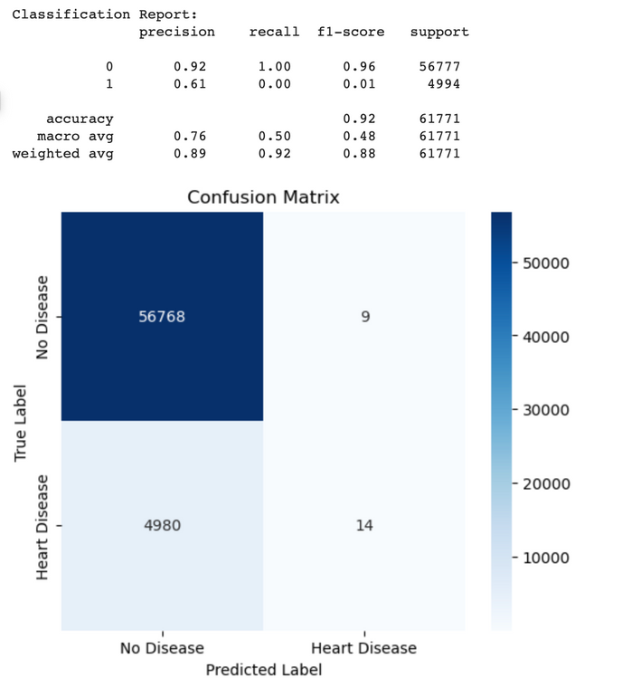
Model 2
RANDOM FOREST MODEL
Accuracy: 0.92 (92% of total predictions were correct)
Macro Avg F1-score: 0.48 (suggests poor balance in performance across both classes)
Weighted Avg F1-score: 0.88 (weighted by class distribution, biased by majority class)
Potential Adjustments:
Balance the dataset
Adjust the decision threshold
Try different algorithms
Feature Engineering

Slide 14
THANK YOU
FOR YOUR ATTENTION

